Slide 1




Volos Summer School
Current tools and best practices for performing genome-wide scans
Konstantinos Hatzikotoulas

Slide 2
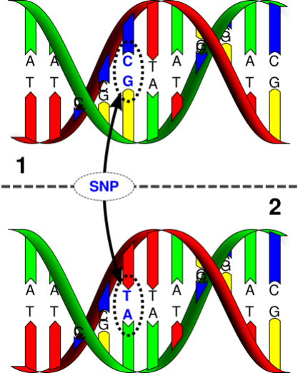

Before we start …
A Single Nucleotide Polymorphism (SNP) is a single base pair at which more than one nucleotide is observed.
The Minor Allele Frequency (MAF) is the relative frequency in a relevant population of the minor (2nd most common) allele.
For biallelic SNPs, if the MAF of T allele is q then the frequency of the C allele is p=1-q.

Slide 3
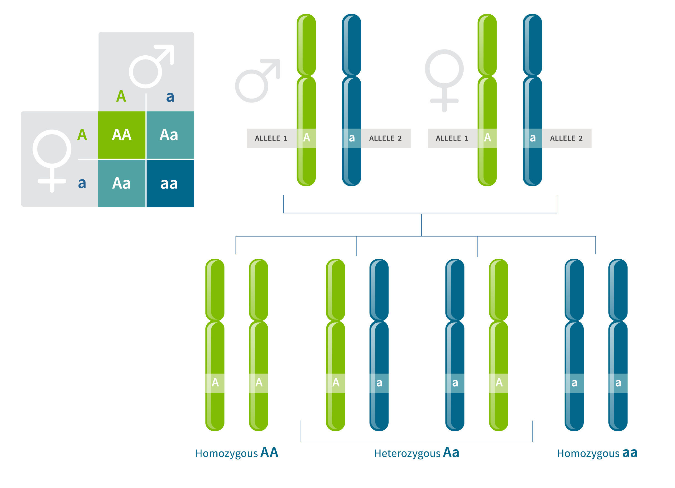
Before we start …
At a given position in the DNA (or genetic locus), the pair of alleles from the two chromosomes makes up the genotype at that position.
SNP genotypes are usually encoded as 0, 1 or 2, based on the number of copies of non-reference alleles.
genotype TT is coded as 0 (homozygous non-reference)
genotype CT is coded as 1 (heterozygous)
genotype TT is coded as 2 (homozygous reference)
https://www.ancestry.com/lp/genotype

Slide 4
Before we start …
SNP genotypes are usually encoded as 0, 1 or 2, based on the number of copies of non-reference alleles.
genotype TT is coded as 0 (homozygous non-reference)
genotype CT is coded as 1 (heterozygous)
genotype CC is coded as 2 (homozygous reference)
Genotypes frequency:
For 1. = q²
For 2.= 2pq
For 3.= p²
https://www.ancestry.com/lp/genotype

Slide 5
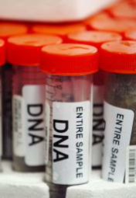

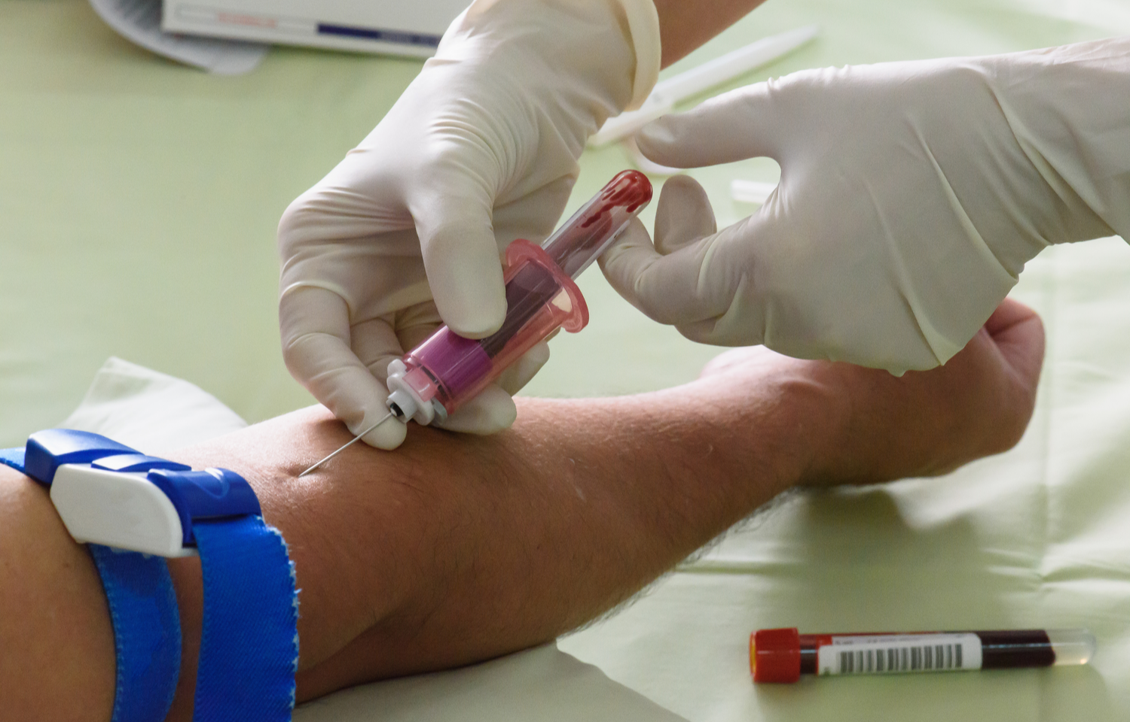

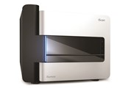
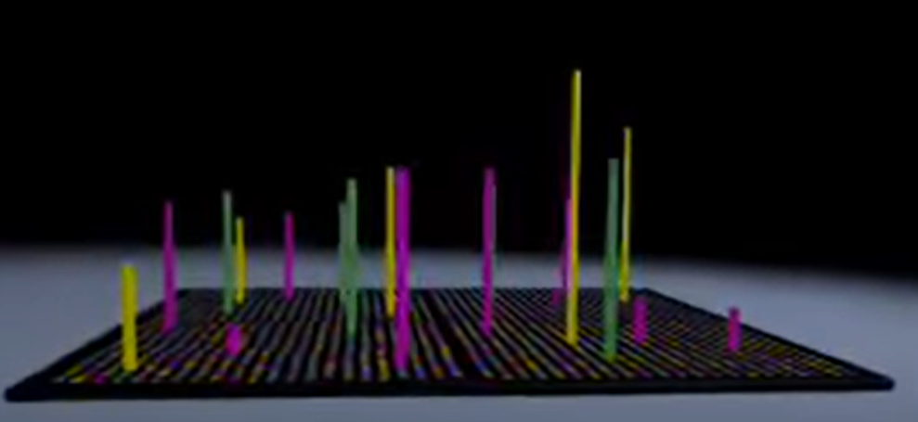
Did you say intensities?

Slide 6
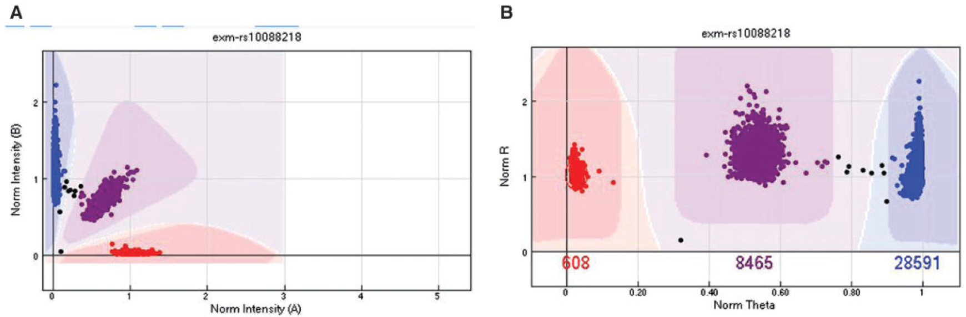
Intensities: the good …
Cartesian coordinates
Polar coordinates
Zhao et al., 2018

Slide 7
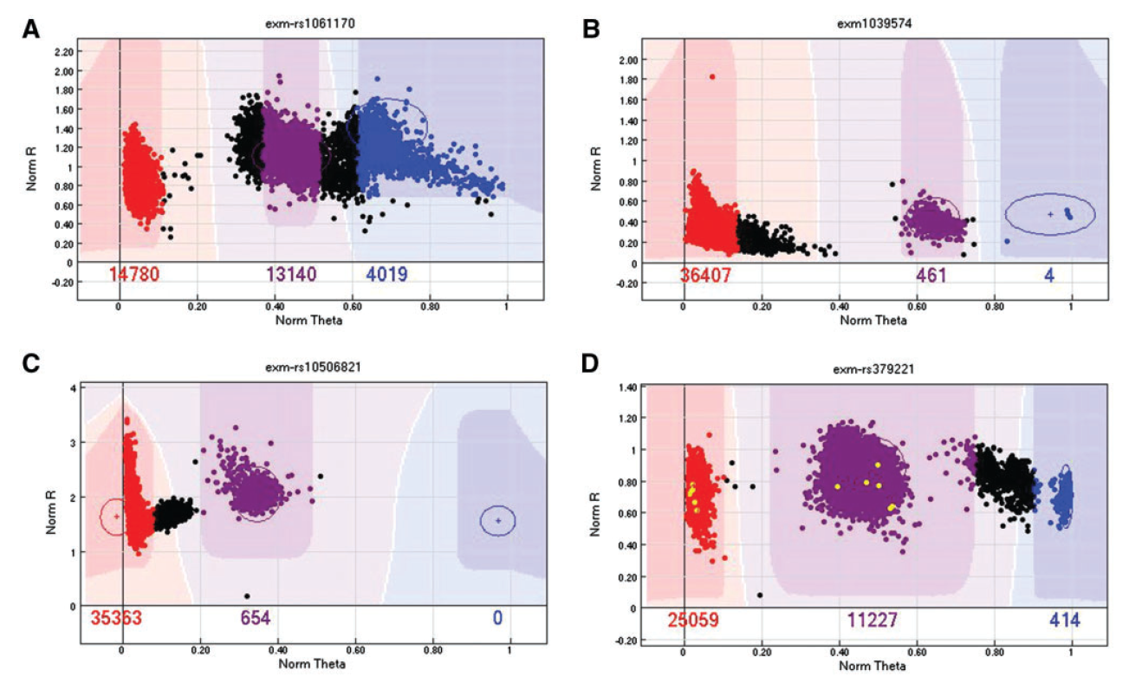
Intensities: the bad …
Zhao et al., 2018

Slide 8
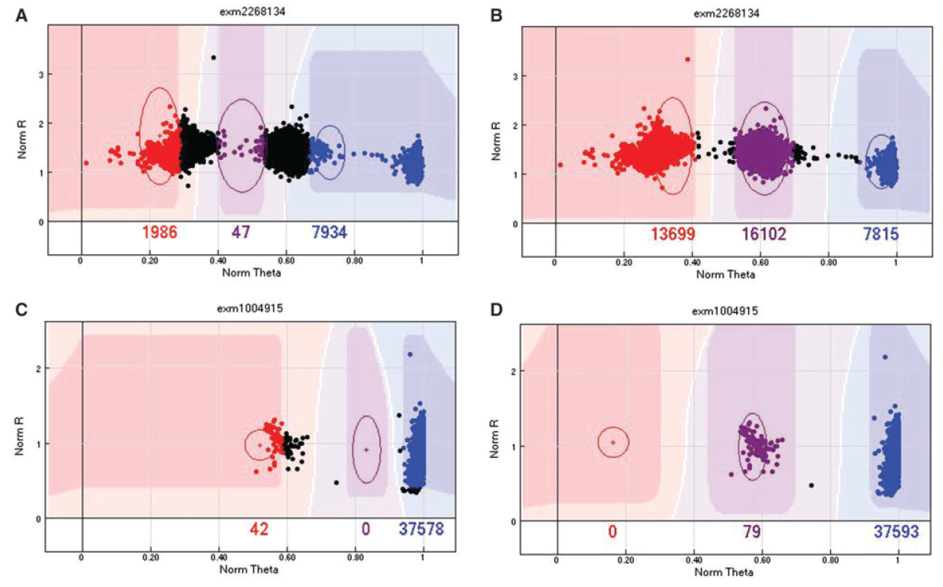
Intensities: the ugly …
Zhao et al., 2018

Slide 9
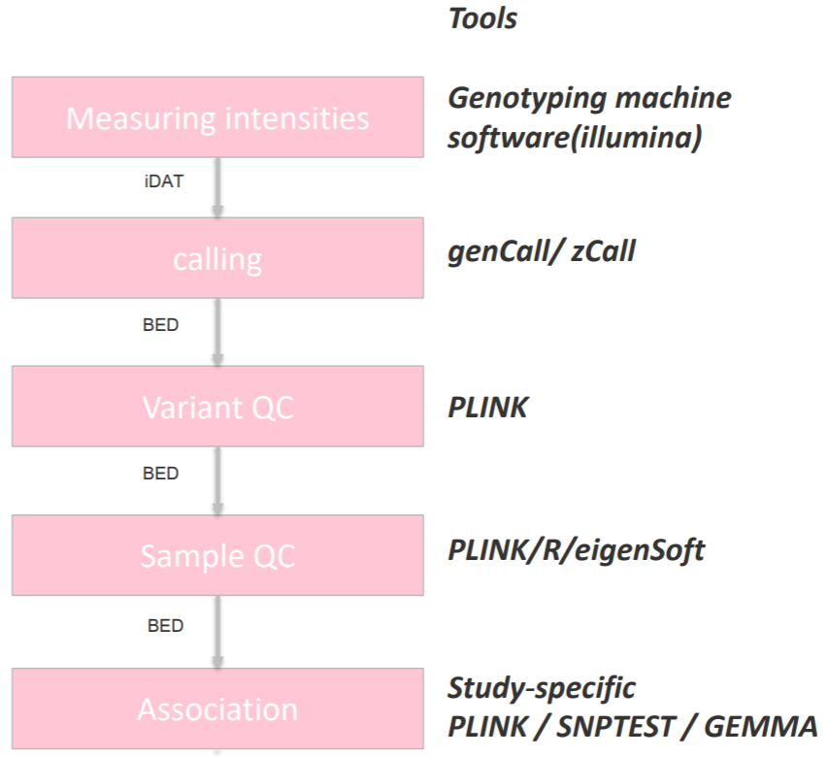
The GWAS analysis pipeline
(Affymetrix)
GenomeStudio

Slide 10
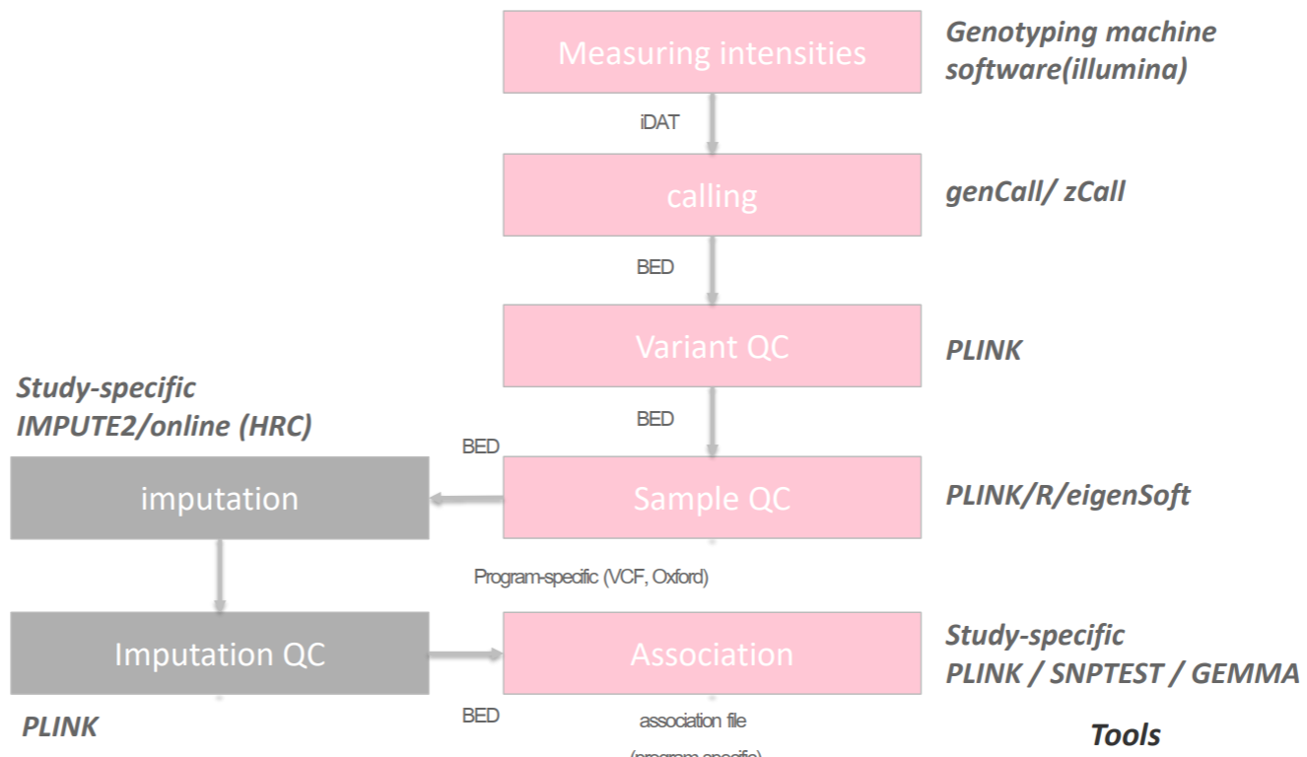
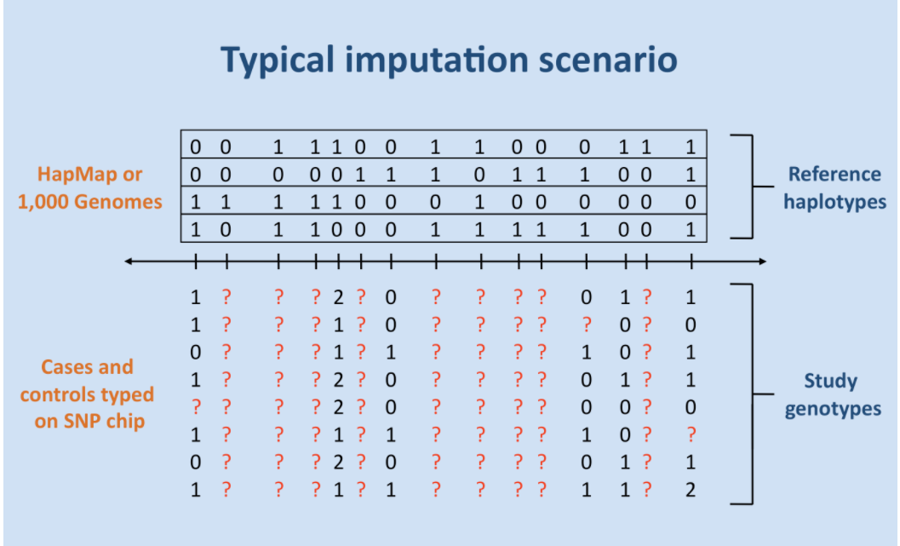
The (imputed) GWAS analysis pipeline

Slide 11
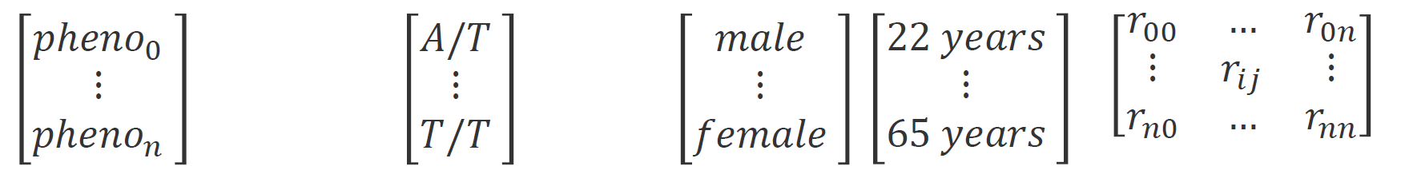
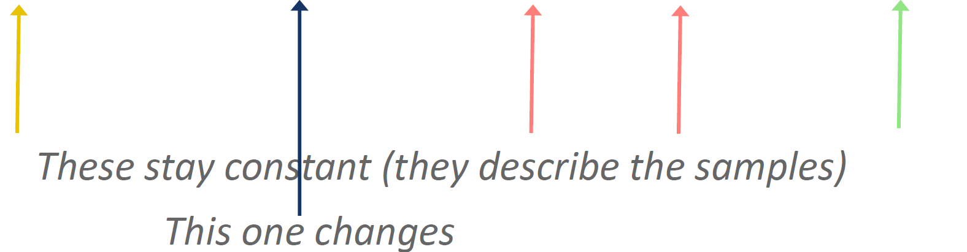
Genotyping data storage
Which data types do we need?
phenotype ~
𝜷×
genotype +
covariates +
structure +
ε

Slide 12
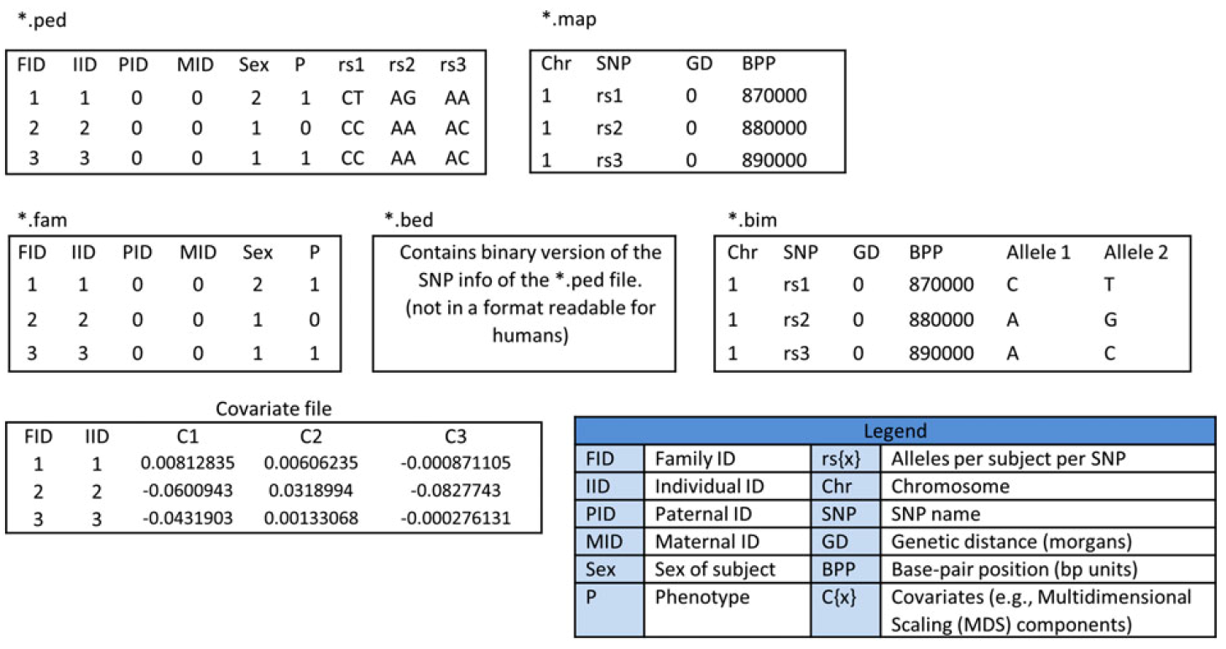
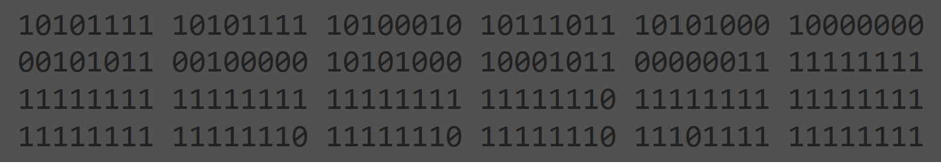
Genotyping data storage: PLINK
Can either be text‐format files or binary files.
Marees et al., 2017

Slide 13
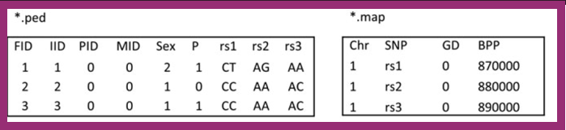
Genotyping data storage: PLINK
ped(igree) file has 6+2n, providing:
Family ID
Individual ID
Paternal ID (0 if father not in dataset)
Maternal ID (0 if mother not in dataset)
Sex (1=Male, 2=Female, 0 or -9=missing)
Phenotype (here 2 or 1, corresponding to case and control)
2 alleles for each SNP (0 = missing)
map(ing) file has 4 columns, providing:
Chromosome
SNP Name
Genetic distance (in morgans)
Base-pair position (bp unit)

Slide 14
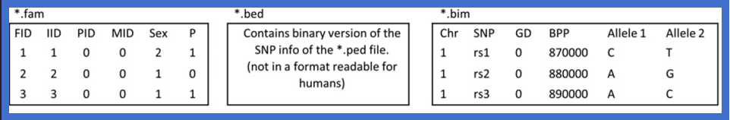
Genotyping data storage: PLINK
fam(ily) ﬁle consists of the ﬁrst six columns of ped ﬁle
The bed (binary pedigree) ﬁle is a matrix of 0s, 1s, 2s or NAs stored in binary format.
PLINK uses the following two-bit coding of genotypes:
00 = A1/A1 (Homozygous non-reference)
01 = A1/A2 (Heterozygous)
11 = A2/A2 (Homozygous reference)
10 = 0/0 (Missing)
bim (binary mapping) file is the .map file plus two columns, providing the A1 and A2 alleles

Slide 15
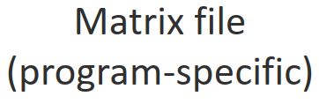
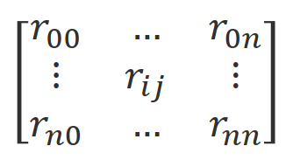
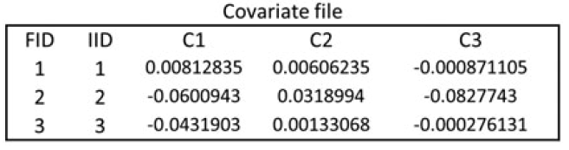
Genotyping data storage: PLINK
What is left?
Phenotype ﬁles have 2 + M columns: Family ID, Individual ID,
then value for each of M phenotypes
Marees et al., 2017

Slide 16
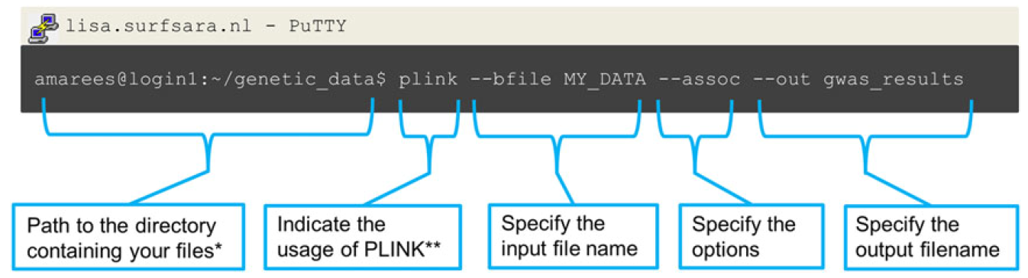
Genotyping data : PLINK common operations
https://www.cog-genomics.org/plink/1.9/index
https://www.cog-genomics.org/plink/2.0/index

Slide 17
Why Quality Control?

Slide 18
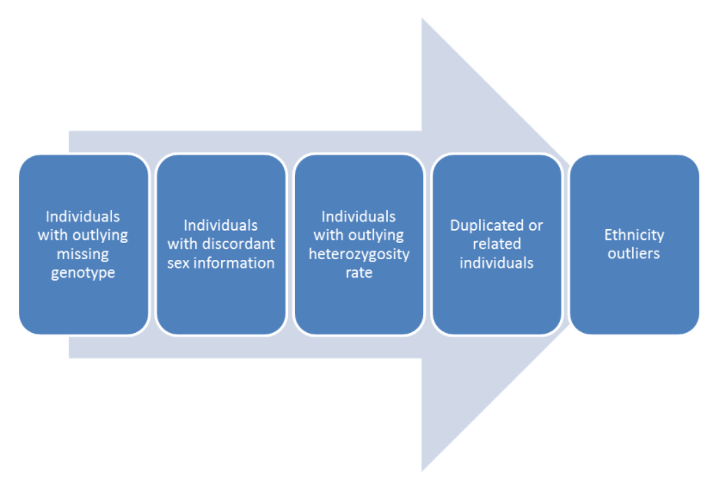
Why Quality Control?
The QC protocol of a GWAS is usually split into two broad categories.
“Sample QC”
“Variant QC”
Identification of variants with an excessive missing genotype
Identification of variants demonstrating a significant deviation from Hardy-Weinberg equilibrium (HWE)
Removal of all makers with a very low minor allele frequency
Removal of all makers with cluster separation score <0.4
Differential missingness (case/control studies)

Slide 19
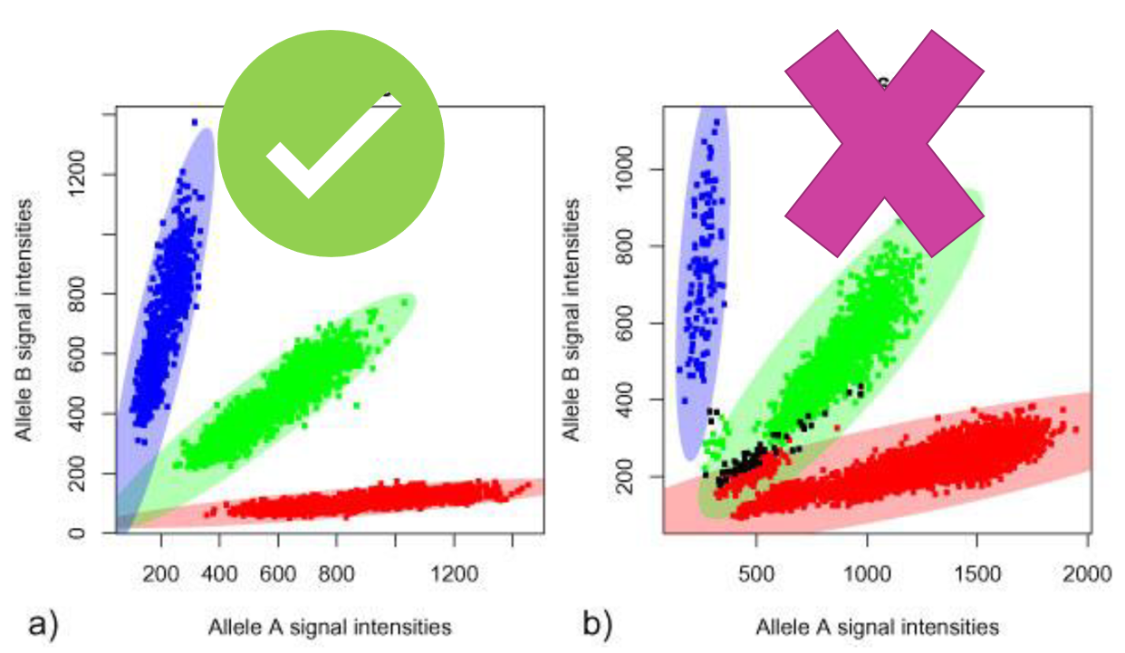
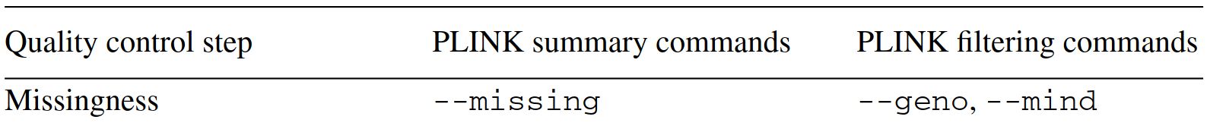
(A generalized) Quality Control process
Missingness
Per sample missingness
% missing for a sample across your variants
Per SNP missingness
% missing for a particular variant among your samples
Low genotyping call rate indicates issues with sample DNA (eg low concentration).

Slide 20
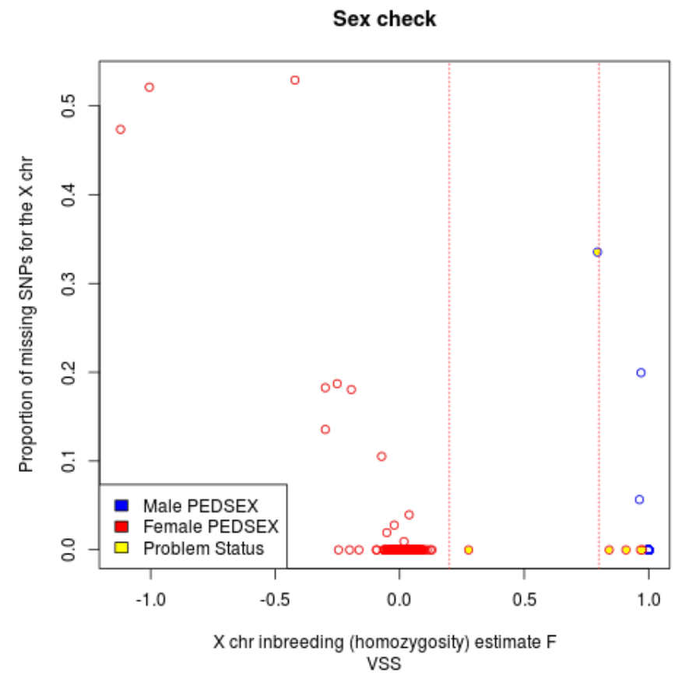
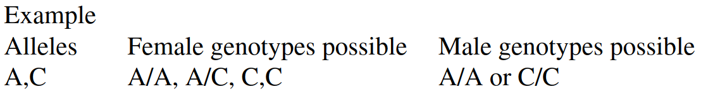
(A generalized) Quality Control process
Discordant Sex Check
Men have only one copy of the X chromosome
All X chromosome data is expected to be homozygous.
X chromosome homozygosity estimate for males (F statistic or inbreeding coefficient) is 1.
In Plink
Male (1) : XHE >0.80
• Female (2) : XHE <0.20
• No sex (0) : 0.20 <XHE <0.80

Slide 21
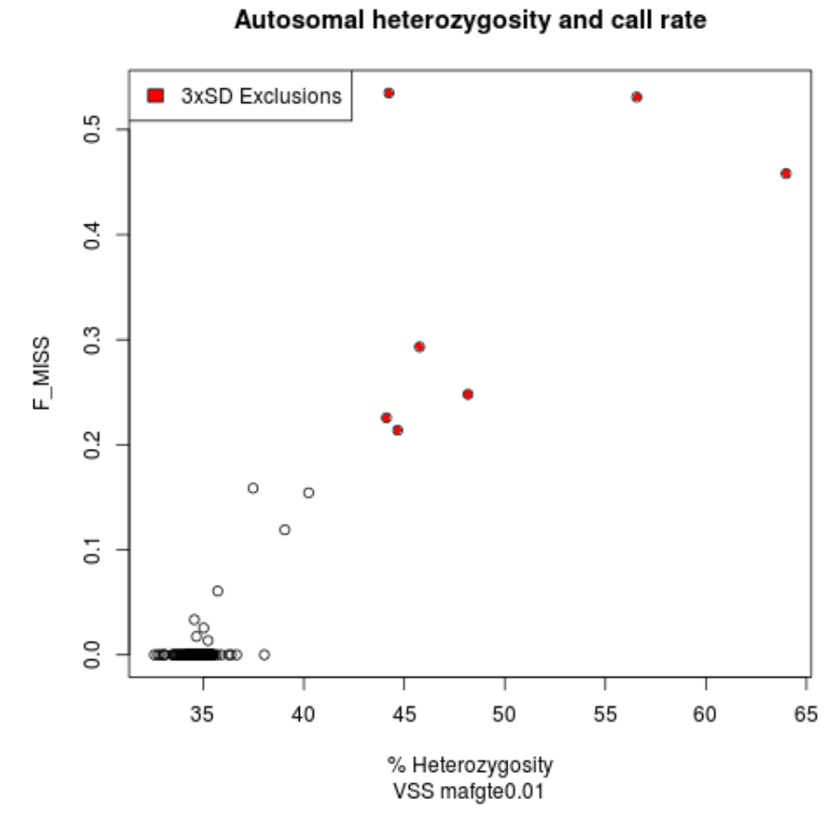
(A generalized) Quality Control process
Heterozygosity rate
The proportion of heterozygous genotypes (per sample)
Various ways of calculating the rate
PLINK: (<observed hom. count> - <expected count>) / (<total observations> - <expected count>))
--het (gives back and F estimate)
<custom scripts>
Excess heterozygosity -> Possible sample contamination
Less than expected heterozygosity –> Possibly inbreeding

Slide 22
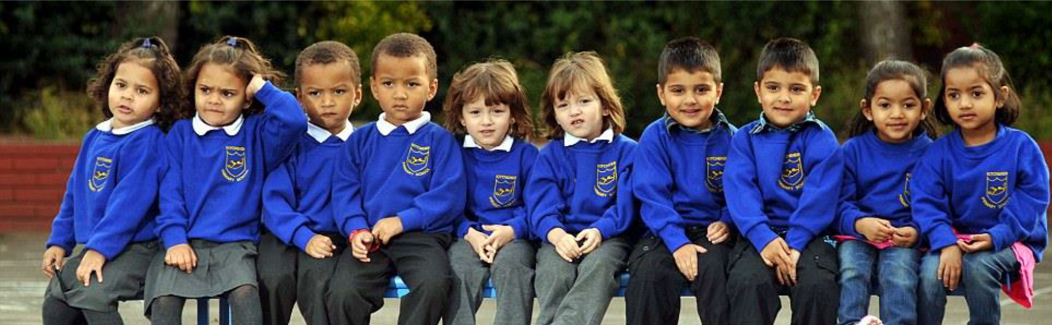
(A generalized) Quality Control process
Duplicated or related individuals
A basic assumption of GWAS: unrelated individuals
Either exclude or account for it
The presence can introduce a bias: genotypes in families to be over-represented

Slide 23
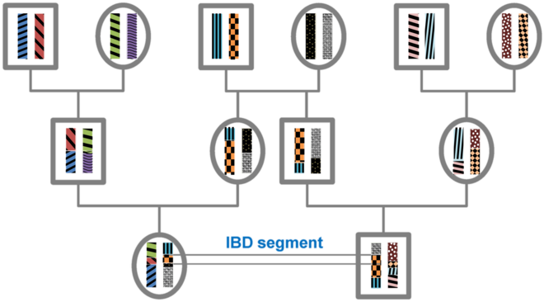
(A generalized) Quality Control process
Duplicated or related individuals
Calculated metrics:
Identity by state (IBS): A DNA segment is identical by state (IBS) in two or more individuals if they have identical nucleotide sequences in this segment.
Identity by Descent (IBD): An IBS segment is identical by descent (IBD) in two or more individuals if they have inherited it from a common ancestor without recombination, that is, the segment has the same ancestral origin in these individuals.
Wikipedia

Slide 24
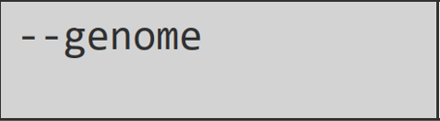

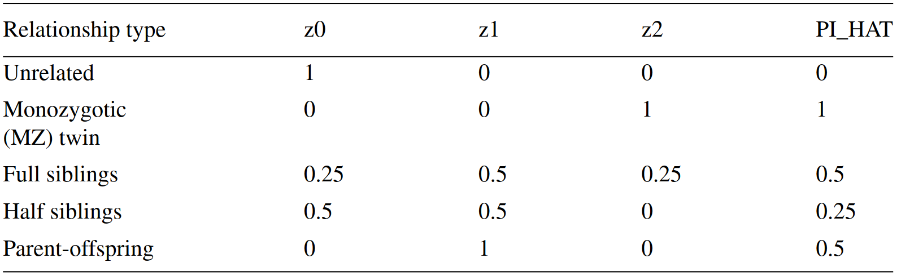
(A generalized) Quality Control process
Duplicated or related individuals
PLINK calculates identity by descent (IBD) of all sample
Approximates the percentage IBD overall, representing pairs as sharing, across all sites:
Zero alleles IBD (z0)
One allele IBD (z1)
Two alleles IBD (z2)
PI_HAT (the proportion IBD, deﬁned as P(IBD = 2) + 0.5*P(IBD = 1)).
Use an independent SNP set before running this command:
removing regions of extended Linkage Disequilibrium (LD)
and
2) pruning the remaining regions so that no pair of SNPs within a given window is correlated.
Slifer, 2018

Slide 25
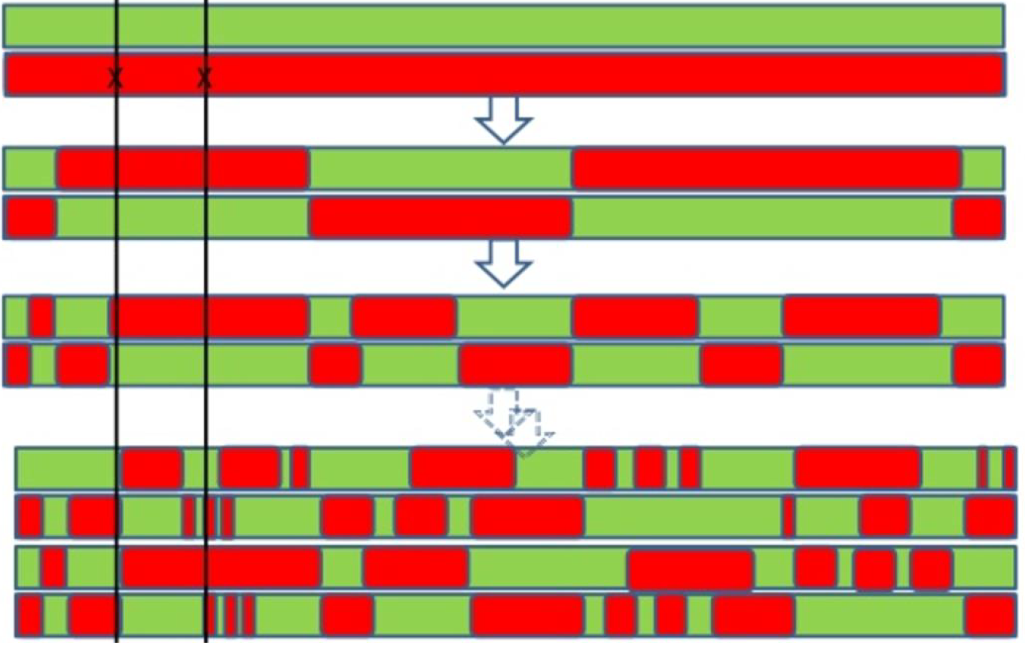
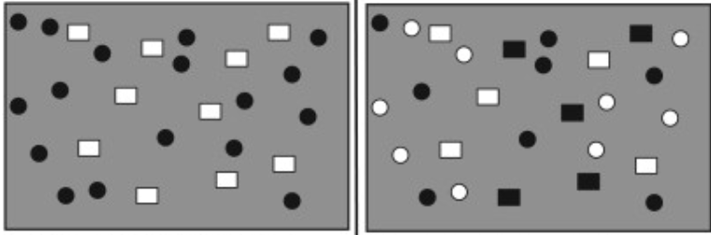
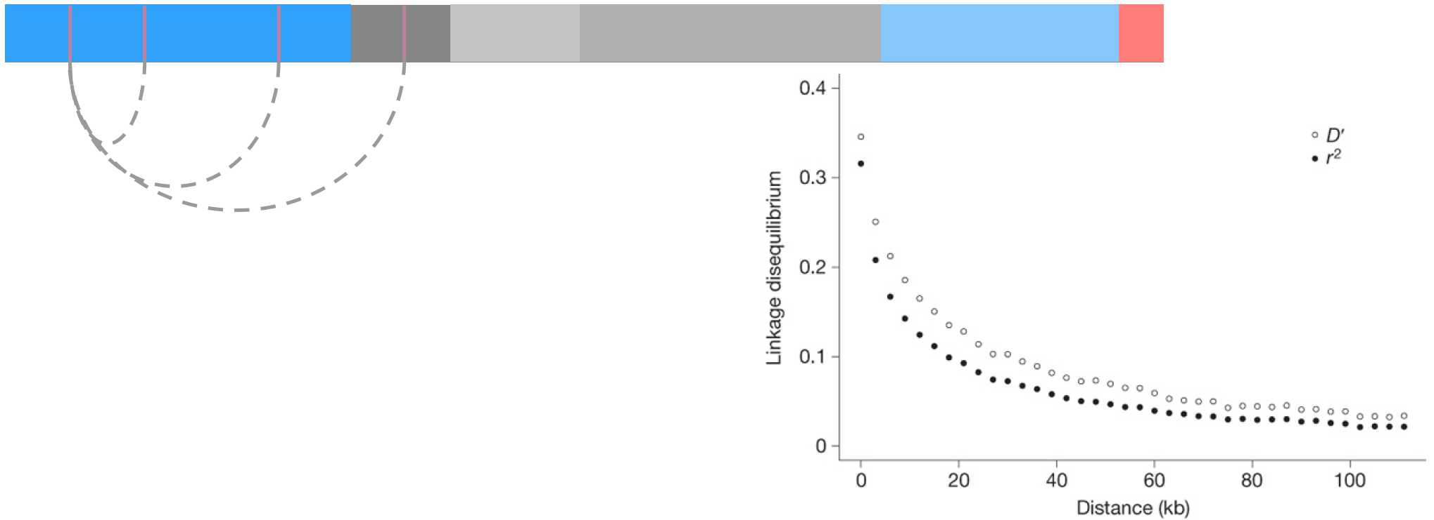
(A generalized) Quality Control process
Linkage disequilibrium (LD)
Is the non-random association of alleles at different loci in a given population.
In GWAS we (mainly) use correlation coefficient between pairs of loci, r²
r²=1 is perfect LD

Slide 26
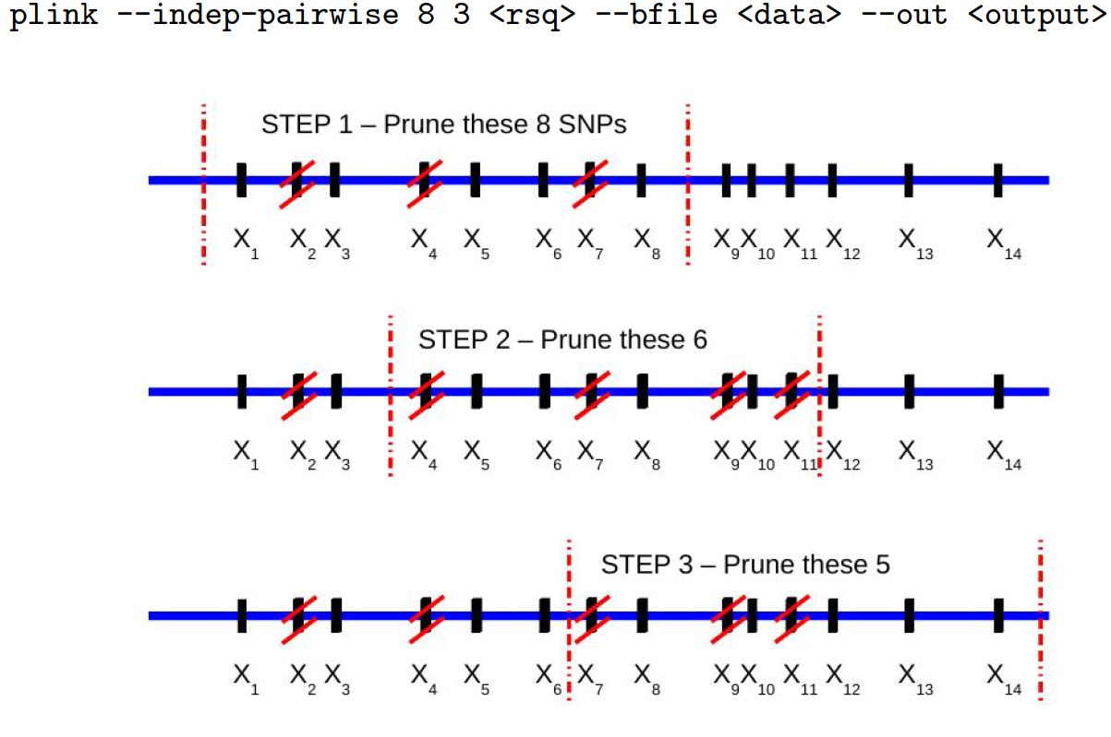
(A generalized) Quality Control process
PLINK: LD-based SNP prunning

Slide 27
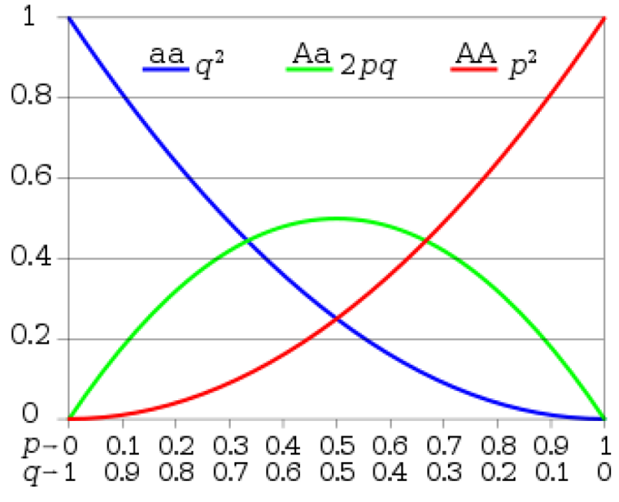
(A generalized) Quality Control process
The Hardy–Weinberg (dis)equilibrium (HWE) law:
The genotype and the allele frequencies are constant over generations.
Assumes:
An indefinitely large population
With no selection, no Mutation, no Migration ……
Significant deviations indicate genotyping errors
PLINK:
Less strict case threshold avoids discarding disease‐associated SNPs

Slide 28
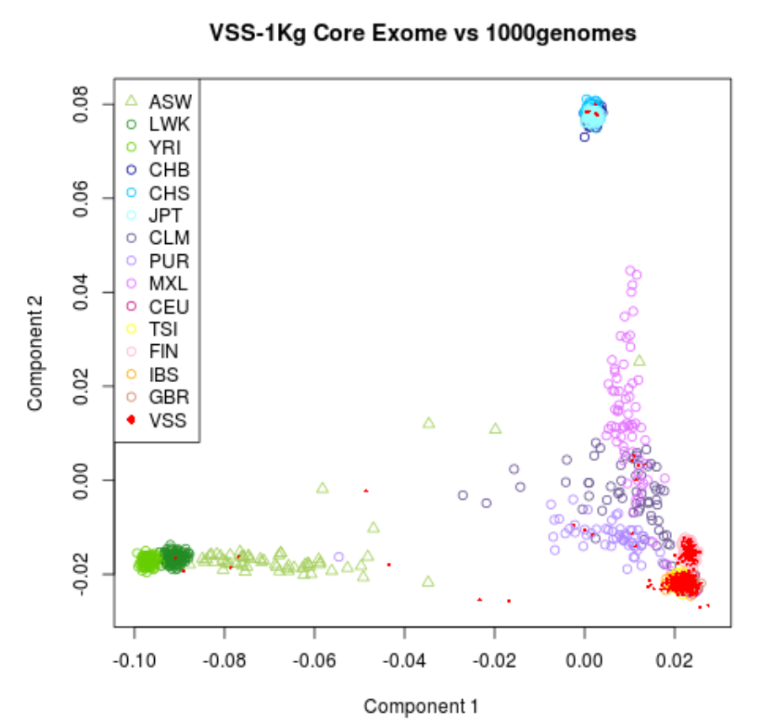
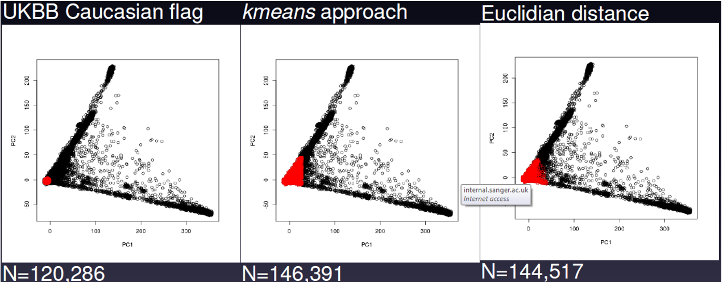
(A generalized) Quality Control process
Population structure
Occurs when samples have different genetic ancestries
Allele frequencies can differ between subpopulations and can lead to spurious associations due to differences in ancestry rather than true associations
PLINK: Merge with a population of known ethnic structure (e.g., HapMap/1KG data) and identify outliers through dimension reduction analyses such as Principal Component Analysis and/or MultiDimensional Scaling (MDS).

Slide 29
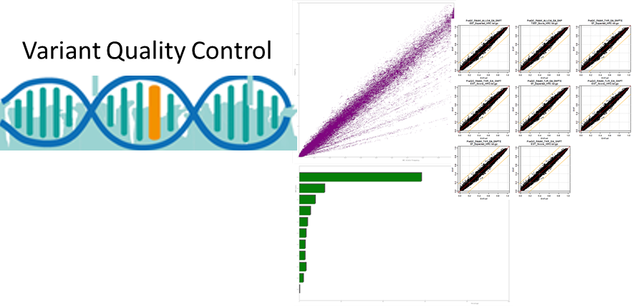
(A generalized) Quality Control process
Variant QC
It consists of (at least) four steps:
1.Identification of variants with an excessive missing genotype
2.Identification of variants demonstrating a significant deviation from Hardy-Weinberg equilibrium (HWE)
3.Removal of all makers with a very low minor allele frequency
4.Removal of all makers with cluster separation score

Slide 30
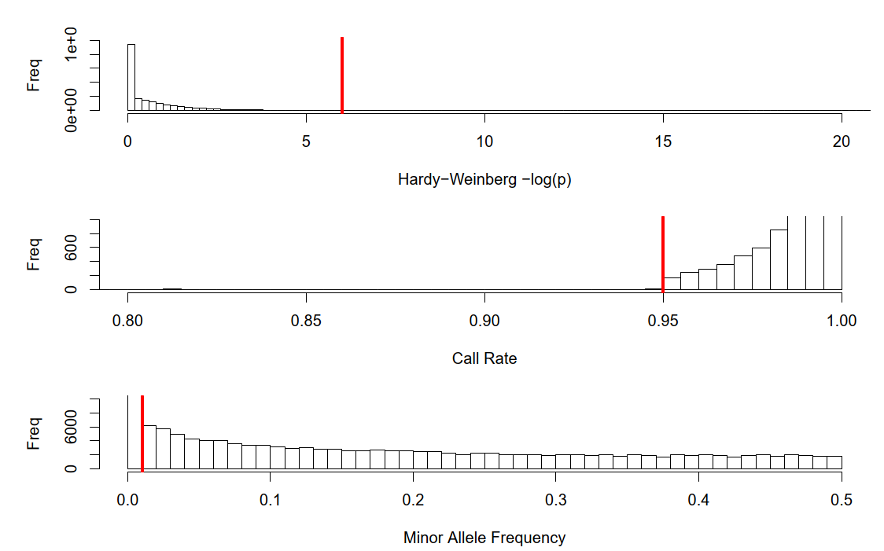
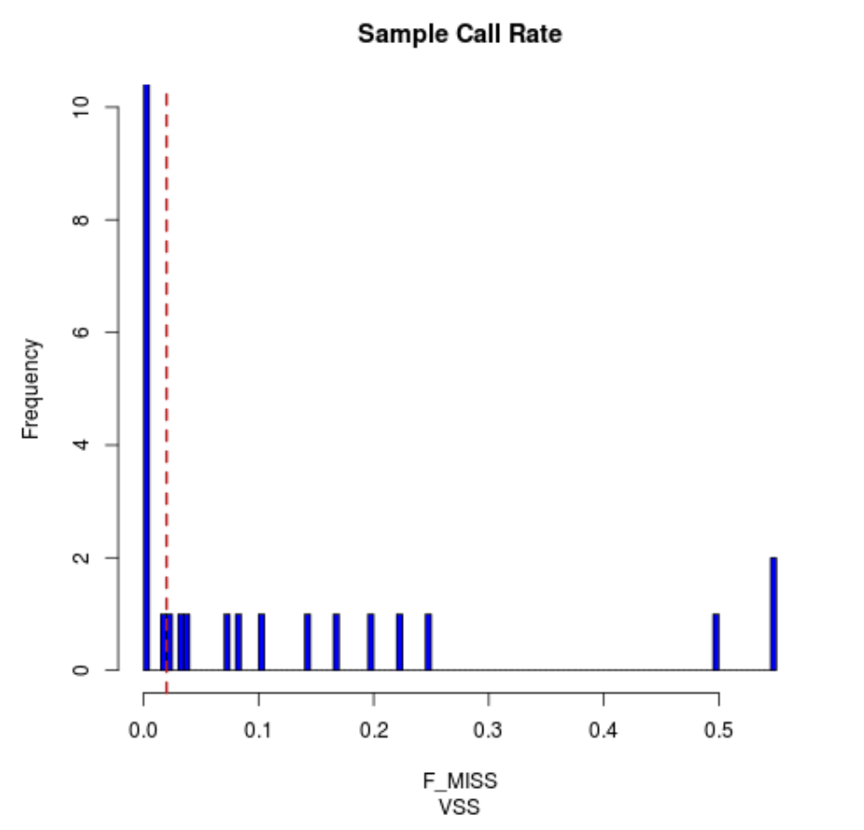
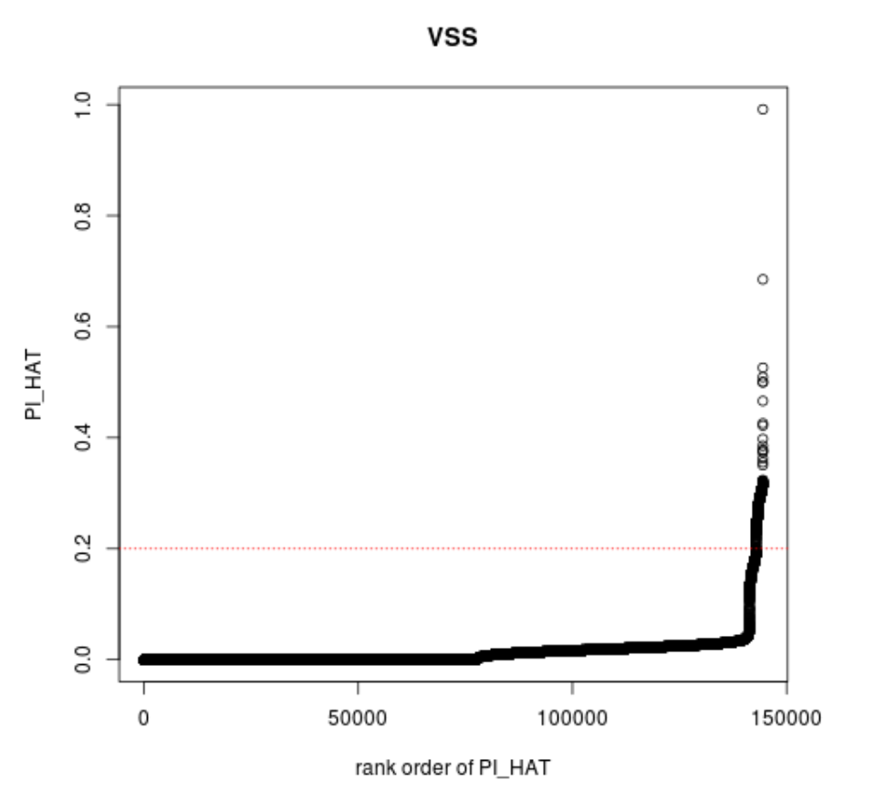
(A generalized) Quality Control process
Where to draw the line?

Slide 31
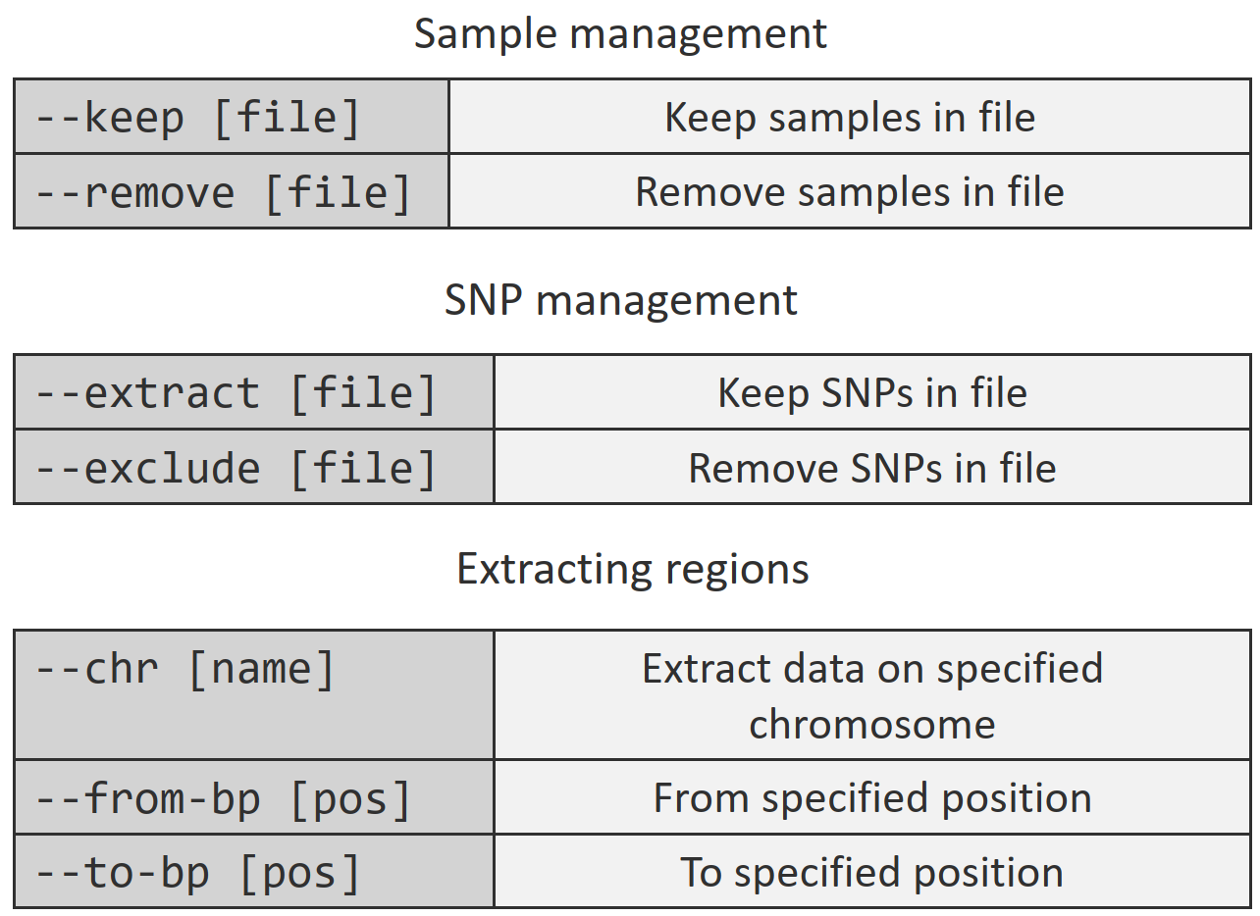
Genotyping data : PLINK common operations

Slide 32
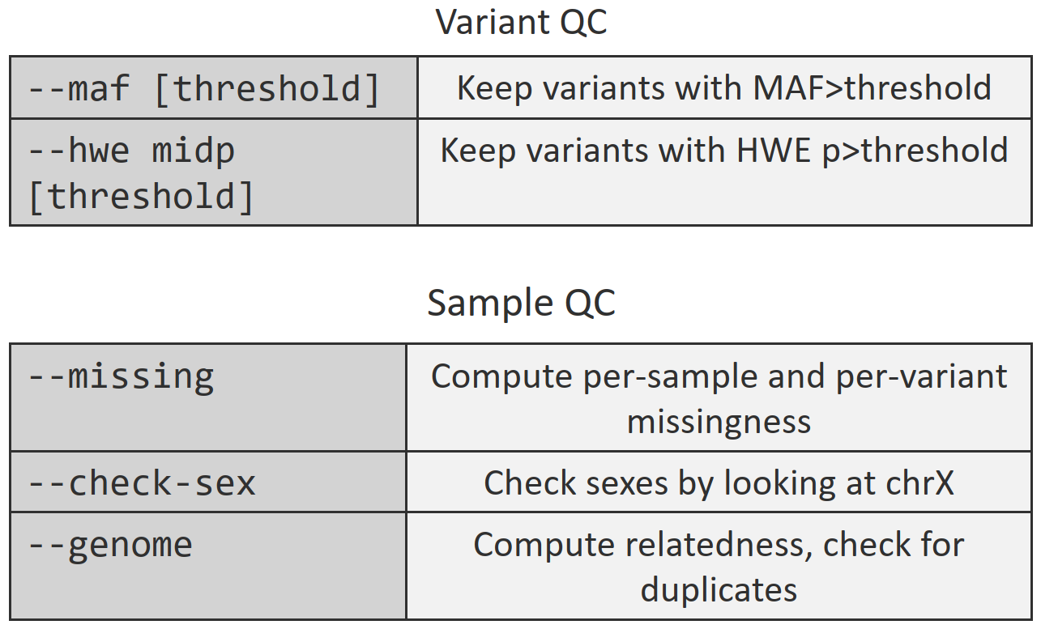
Genotyping data : PLINK common operations

Slide 33
Genotyping data : PLINK common operations
What is the command for :
Excluding SNPs that are missing in a large proportion of the subjects (<0.90).
Excluding individuals who have high rates of genotype missingness (<0.85).
Keeping autosomal SNPs.
Extracting the top 20 principal components.
The association between SNPs and a binary/quantitative outcome.

